Slide 1
Analysis of 2003-2018 San Francisco Crime Data
Wanran Li

Slide 2
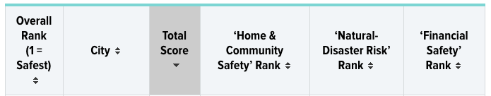
I. San Francisco high in crime
https://wallethub.com/edu/safest-cities-in-america/41926/#main-findings

Slide 3
II. Data acquisition & cleaning
Combine 2 major datasets: Police Department Incident Reports from 2003 to May 2018 and 2018 to Present
Data shape (1822068, 17) after removing duplicates and columns with too many null value
Other data sets:
SF Temperature (2014-2018)
Unemployment Rate (2003-2018)
Homeless Population (2005-2017)
SF median household income (2006-2018)

Slide 4
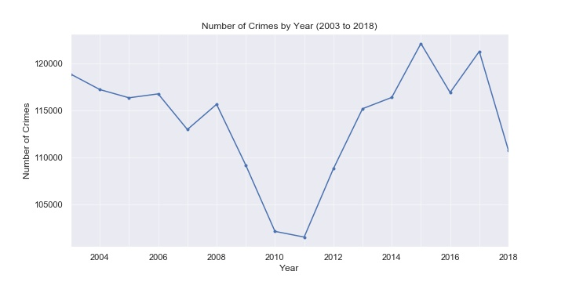
III. EDA 3.1 timing of SF crime
Annual crime count: V shape

Slide 5
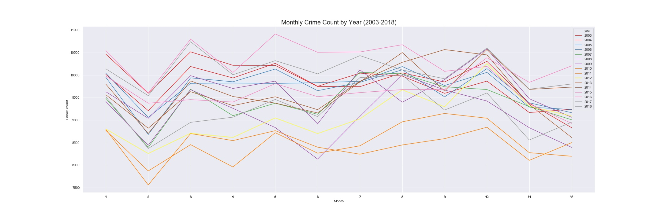
Monthly trend by year: top 3 months are Oct, Aug & Mar

Slide 6
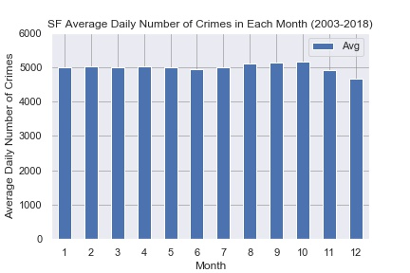
Average daily # of crimes by month
Highest : Oct, Sept, Aug
Lowest: Dec Nov

Slide 7
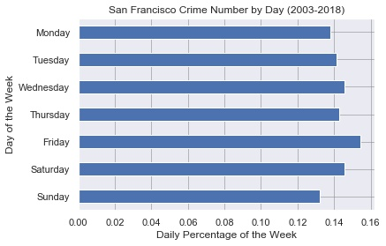
Crime count by day of the week
Highest: Fri, Sat, Wed
Lowest: Sun, Mon

Slide 8
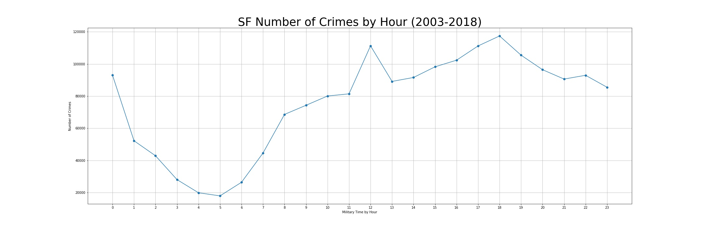
Crime count by hour
Highest: daytime, peaks at 12pm, 18pm
Lowest: nighttime, hits bottom at 5am

Slide 9
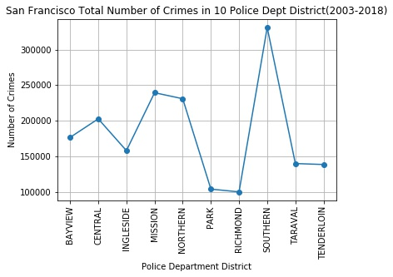
3.2 SF crime by area
Crime count by police districts
Tenderloin isn’t as dangerous as we thought
Highest: Southern, Mission
Lowest: Park, Richmond, Tenderloin

Slide 10
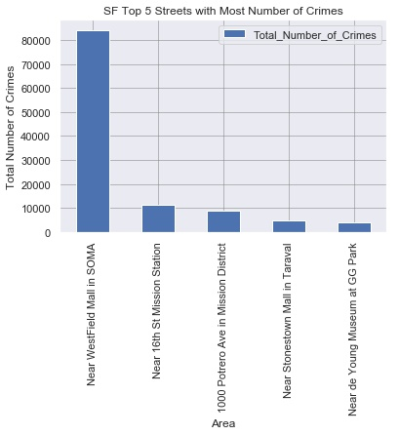
Streets with most crimes:
Near Westfield Mall in SOMA
16th St Mission Station
1000 Potrero Ave in Mission District
Near Stonestown Mall in Taraval
Near de Young Museum at GG Park

Slide 11
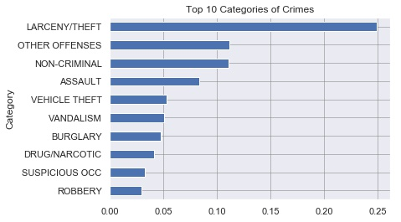
3.3 Categories and decription of SF Crime
Most common categories:
Larceny/theft
Other offenses: mostly traffic related
Non-criminal: assault, vandalism, burglary

Slide 12
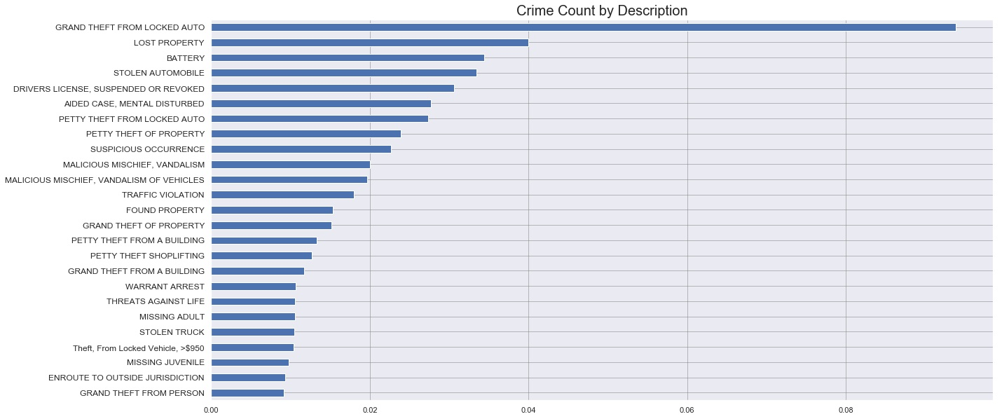
Most common crimes by description:
Most are vehicle related
The top 25 types by description below accounts for 50% of crimes

Slide 13
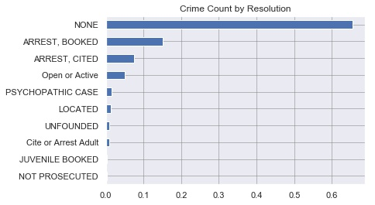
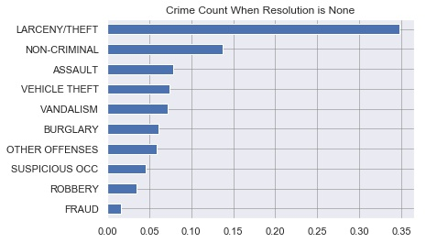
Crime count by resolution
65%: no actions taken
15%: arrests, booked (police taking suspect’s info, fingerprints and mug shots etc.)
7%: arrests, cited (for misdemeanor, e.g. a traffic ticket)

Slide 14
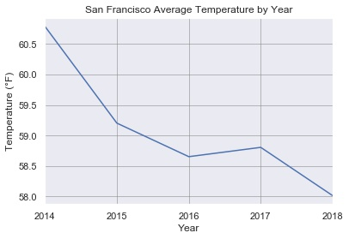
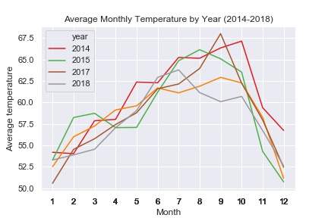
3.4 SF crime and other data sets
SF temperature (2014-2018)
Warmest: fall vs Coldest: winter

Slide 15
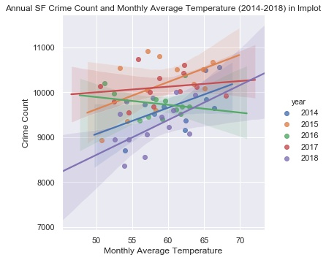
SF Crime Count & Temperature by Year
Positively related in all years except for 2016

Slide 16
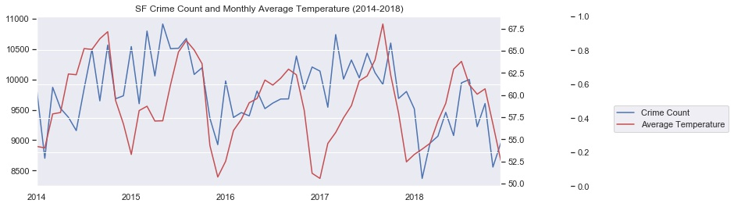
SF Crime count & temperature by month
Lowest crime count in winter: Dec, Nov
Highest crime count in fall: Oct, Sept

Slide 17
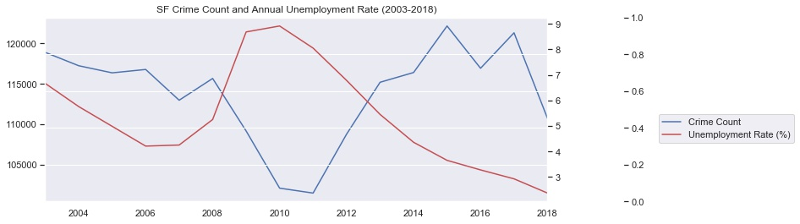
SF crime count and unemployment rate (2003-2018)
Unemployment rate has some impact, but not strongly correlated

Slide 18
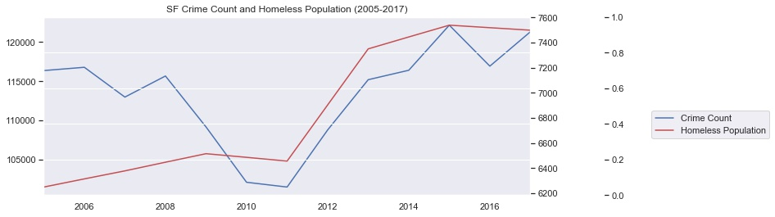
SF crime count and homeless population
Strong positive correlation, especially after 2009

Slide 19
IV. Limitations
We could explore more about types of crimes based on location and time
Recording categories in a more consistent manner. (e.g. “Stolen Property” and “Larceny/Theft” are the same)
Our accuracy of studying the correlation between crime count and homeless population can be improved if the homeless count is performed yearly instead of every other year, so we don’t need to use estimate for the years in between

